Slide 1

CSE 465 - Pattern Recognition and Neural Networking
Talbia Kabir ID - 1521165042

Slide 2

“Automatic Character Identification System From Video”
Based on: Convolutional Neural Network (CNN)

Slide 3
DESCRIPTION
This work aims to realize a recognition system for a software engine that will automatically detect character using Convolutional Neural Networks (CNNs) from a video content. This system actually includes tracking a certain character from any content like TV show, cinema, or any other source and to count how many times the character is in frames. The main part of the work is:
Detecting and identifying characters from any videos or movies
Tracking and clustering faces from videos and extracting names from script
Counting how many times a character is entering in the frame

Slide 4

FACE RECOGNITION SYSTEM
The face recognition system generally involves two stages:
Face Detection – where the input image is searched to find any face, then image processing cleans up the facial image for easier recognition.
Face Recognition – where the detected and processed face is compared to the database of known faces to decide who that person is.

Slide 5
LIBRARIES
For the face recognition in both images and video streams, the libraries I have used:
NumPy
Pandas
Matplotlib
Keras
Skimage
OpenCV
To perform face recognition with Python and OpenCV, I used two additional libraries:
The Dlib library contains implementation of “deep metric learning” to construct face embeddings used for the actual recognition process.
The Face_Recognition library wraps around dlib’s facial recognition functionality that makes it easier to work with.
Dataset
The face recognition dataset was created programmatically with Python and the Bing Image Search API.

Slide 6
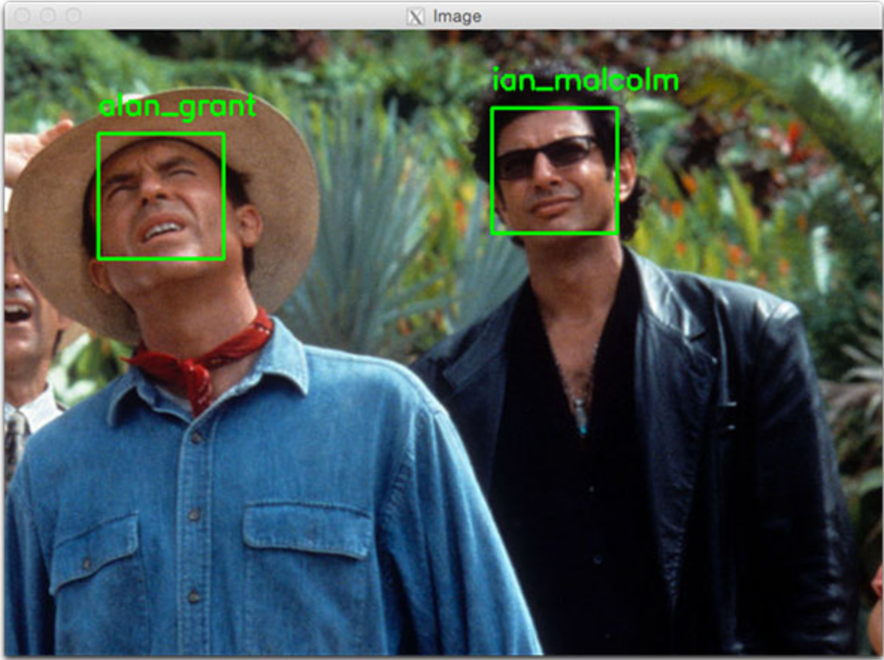
DETECTION
Before encoding faces in images, first I needed to detect them. Two face detection methods include either HOG (Histogram of Oriented Gradients) or CNN (Convolutional Neural Network). These two flags are the only ones that will work for detection method.

Slide 7
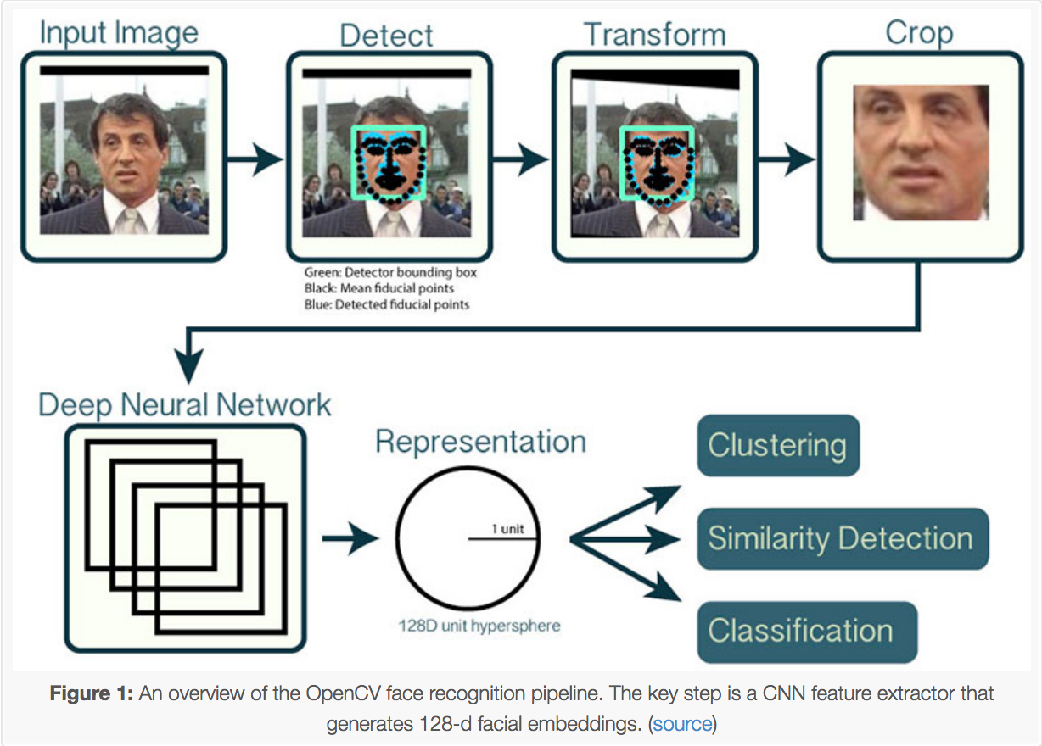
HOW RECOGNITION WORKS
In order to build OpenCV face recognition pipeline, deep learning is shown in two key steps:
To apply face detection, which detects the presence and location of a face in an image
For encoding the faces, 128-d embeddings on a dataset of ~3 million images extracted to quantify each face in an image

Slide 8
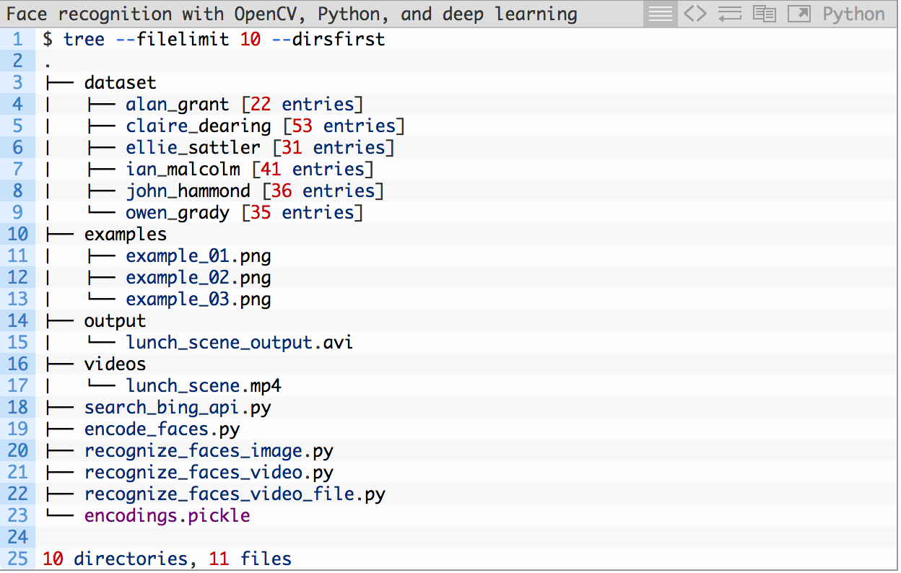
PROJECT STRUCTURE
Project structure can be seen by examining the output from the tree command:
It has 4 top-level directories:
dataset/
examples/
output/
videos/

Slide 9
DIFFICULTIES
For face detection, at first I used HOG (Histogram of Oriented Gradients) method but I did not get an accurate result. Then I used CNN (Convolutional Neural Network) to make it work.
I tried using the pre-trained model without removing the top layer. The results were not satisfactory. To tackle this problem, I retrained the model using few labelled images and the results were better than the previous results.

Slide 10
FUTURE WORK
Detect characters from movies.
Track a certain character from any content like TV show, cinema, or other sources and count how many times the character enters in the frame.

